Slide 1
An Architectural Framework for Autonomous Software Development via Multi-Agent Systems
Zachary Nanfelt

Slide 2
Table of Contents
Software's Pain Points: Introduction
Software Factory Unveiled
Agent Swarm: Specialized Teams
Built-In Quality, Security, Compliance
AI Advantage: Fast & Secure
AI Challenges and Futures
AI: Future is Now!

Slide 3

Software's Pain Points: Introduction
Current development has cycles, errors, and complexity.
Shift the Software Development Life Cycle paradigm now.
Automate software development from PRD to production.
Software complexity and human error are current challenges.
Lengthy development cycles need to be addressed.
Notes:
I. Introduction (Hook & Problem)
A. Start with a compelling statement about the current challenges in software development:
Lengthy development cycles.
Human error and inconsistencies.
Difficulty handling increasing software complexity.
B. Introduce the concept of a paradigm shift in the Software Development Life Cycle (SDLC).
C. Briefly mention the vision: Automating software development from Product Requirements Document (PRD) to production autonomously.

Slide 4

Software Factory Unveiled
Autonomous Factory takes PRD as input.
AI agents manage the software creation process.
Factory outputs production ready software directly.
Key stages involve design and code generation.
Core components include agent orchestrator system.
Notes:
II. The Proposed Solution: Autonomous Software Factory
A. Explain the "Autonomous Software Factory" concept:
Input: Product Requirements Document (PRD).
Output: Production-ready software.
Process: Managed by specialized AI agents.
B. Key Stages of the Automated Process:
PRD Intake and Analysis.
Design and Architecture.
Code Generation and Implementation.
Testing and Quality Assurance (QA).
Security and Compliance.
Iterative Refinement.
Deployment.
Monitoring and Feedback.
C. Core Components of the System:
PRD Ingestion Engine.
Agent Orchestrator.
Knowledge Base (Vector DB / RAG).
Tool Repository & Execution Environment.
Output Delivery & Monitoring Module.

Slide 5
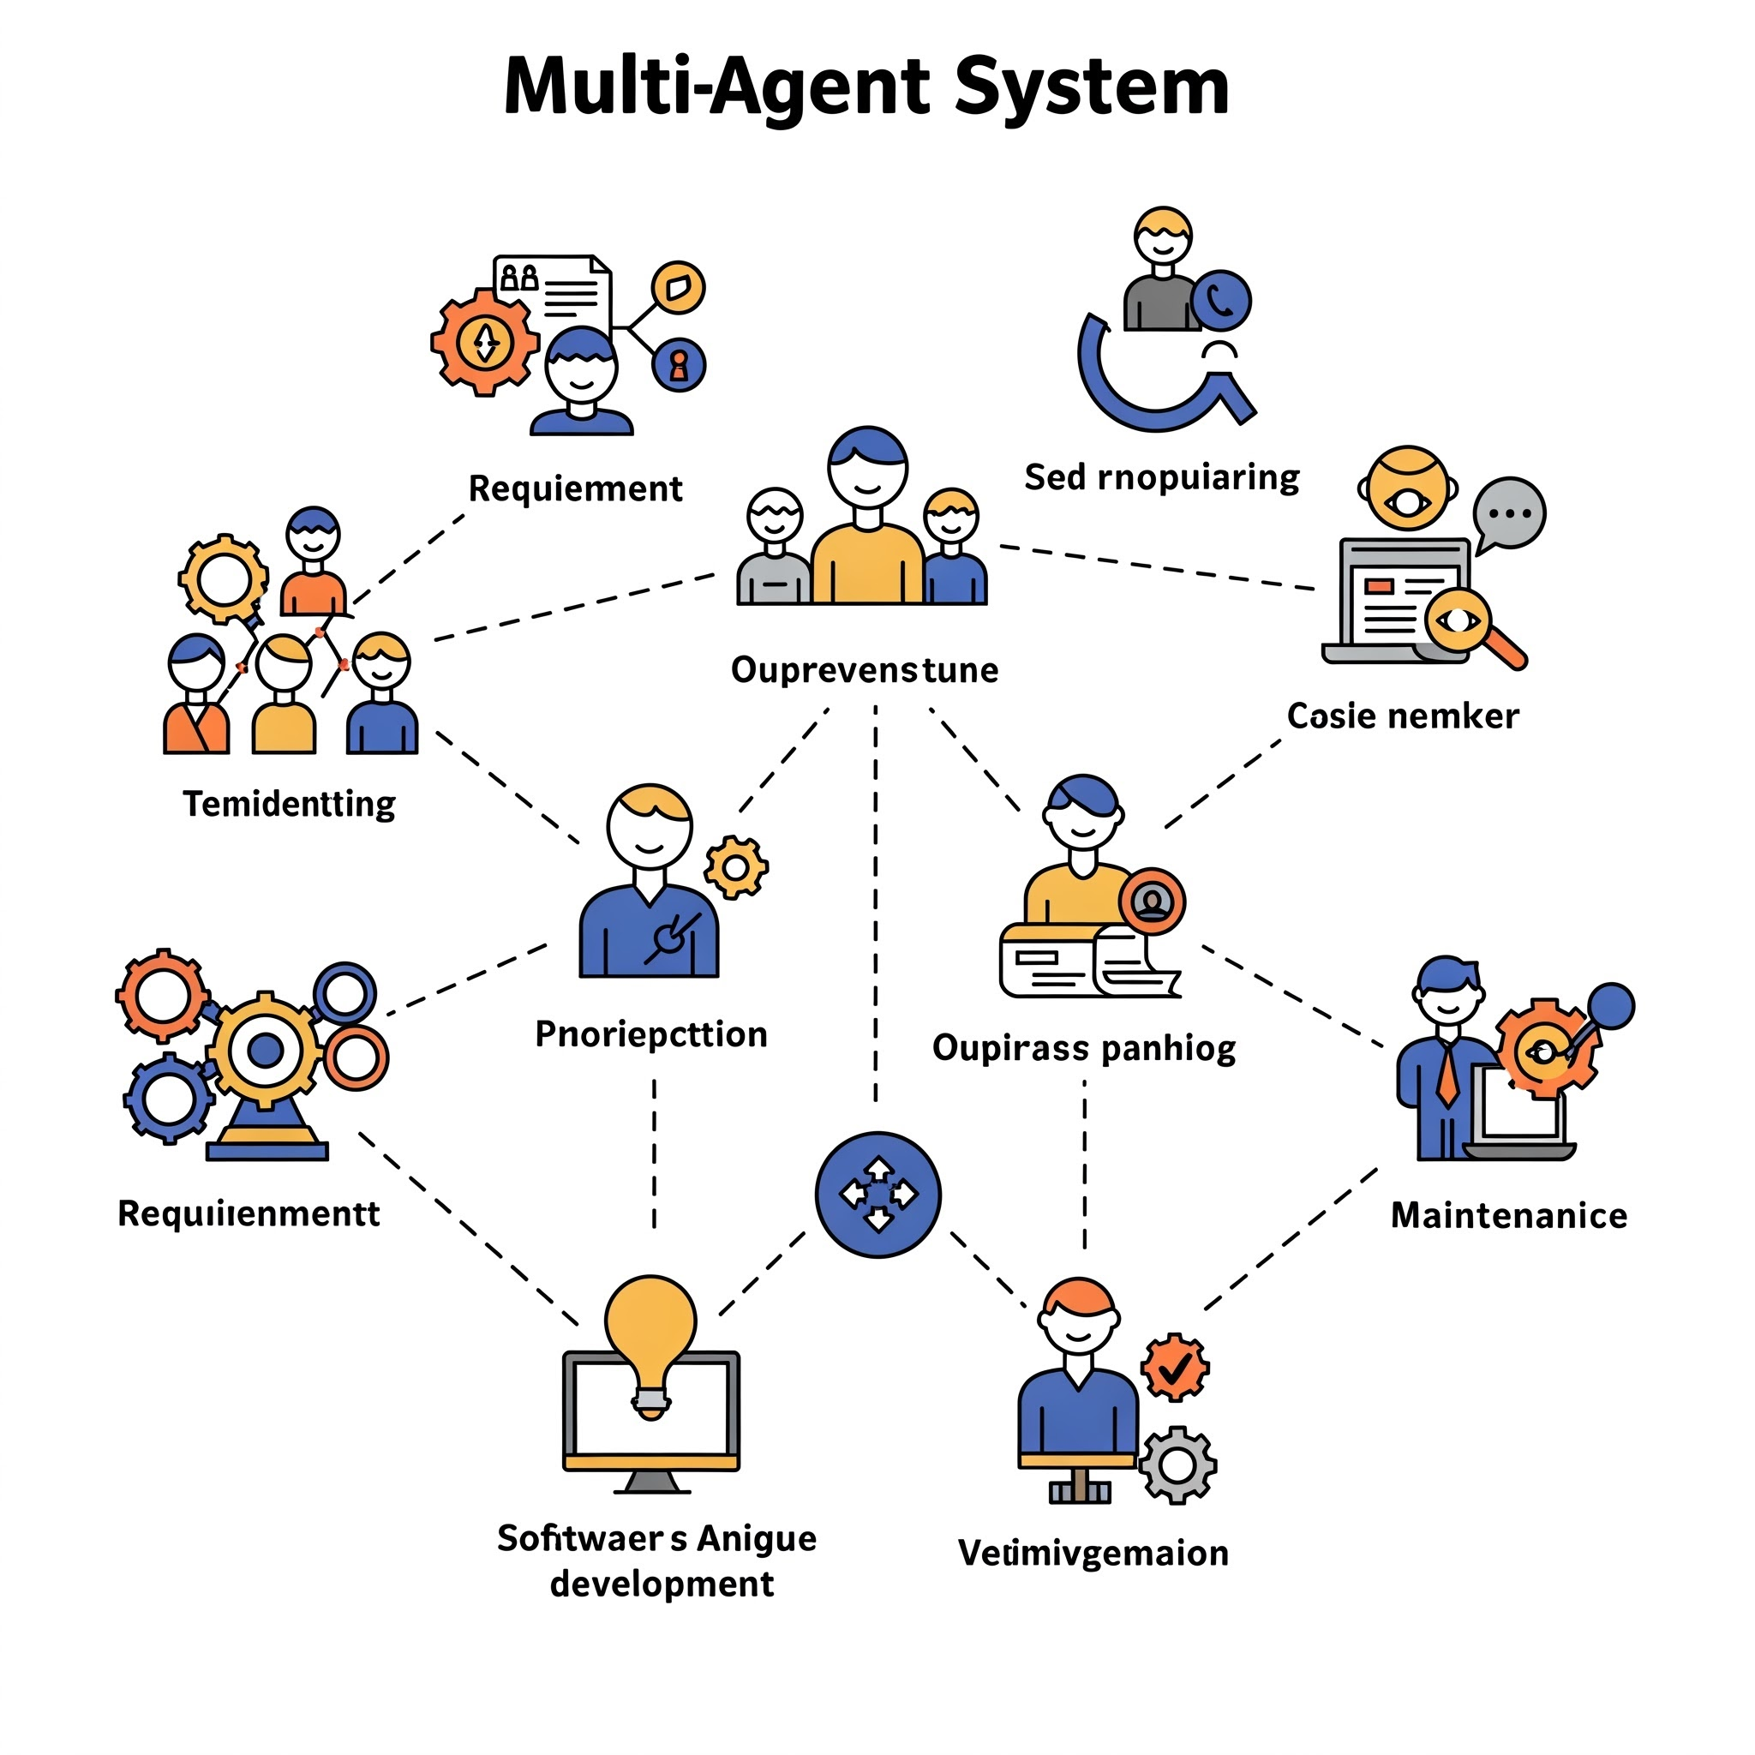
Agent Swarm: Specialized Teams
Multi-agent system is needed with specialized agents for efficiency.
Key roles include analysts, architects, and project managers.
Developers, QA, security, compliance, and deployment agents are crucial.
Orchestration and communication protocols are highly important.
Potential frameworks and standards enable better agent collaboration.
Notes:
III. The Agent Swarm: Specialization and Collaboration
A. Explain the need for a multi-agent system (MAS) with specialized agents.
B. Key Agent Roles and Responsibilities (brief overview):
Requirements Analyst.
Architect.
Project Manager.
Developer(s).
QA Agent.
Security Agent.
Compliance Agent.
Deployment Agent.
Refinement/Critique Agent.
C. Agent Collaboration and Communication:
Mention the importance of orchestration and communication protocols.
Briefly touch upon potential frameworks (e.g., LangGraph, Agency Swarm) and standards (e.g., A2A).

Slide 6
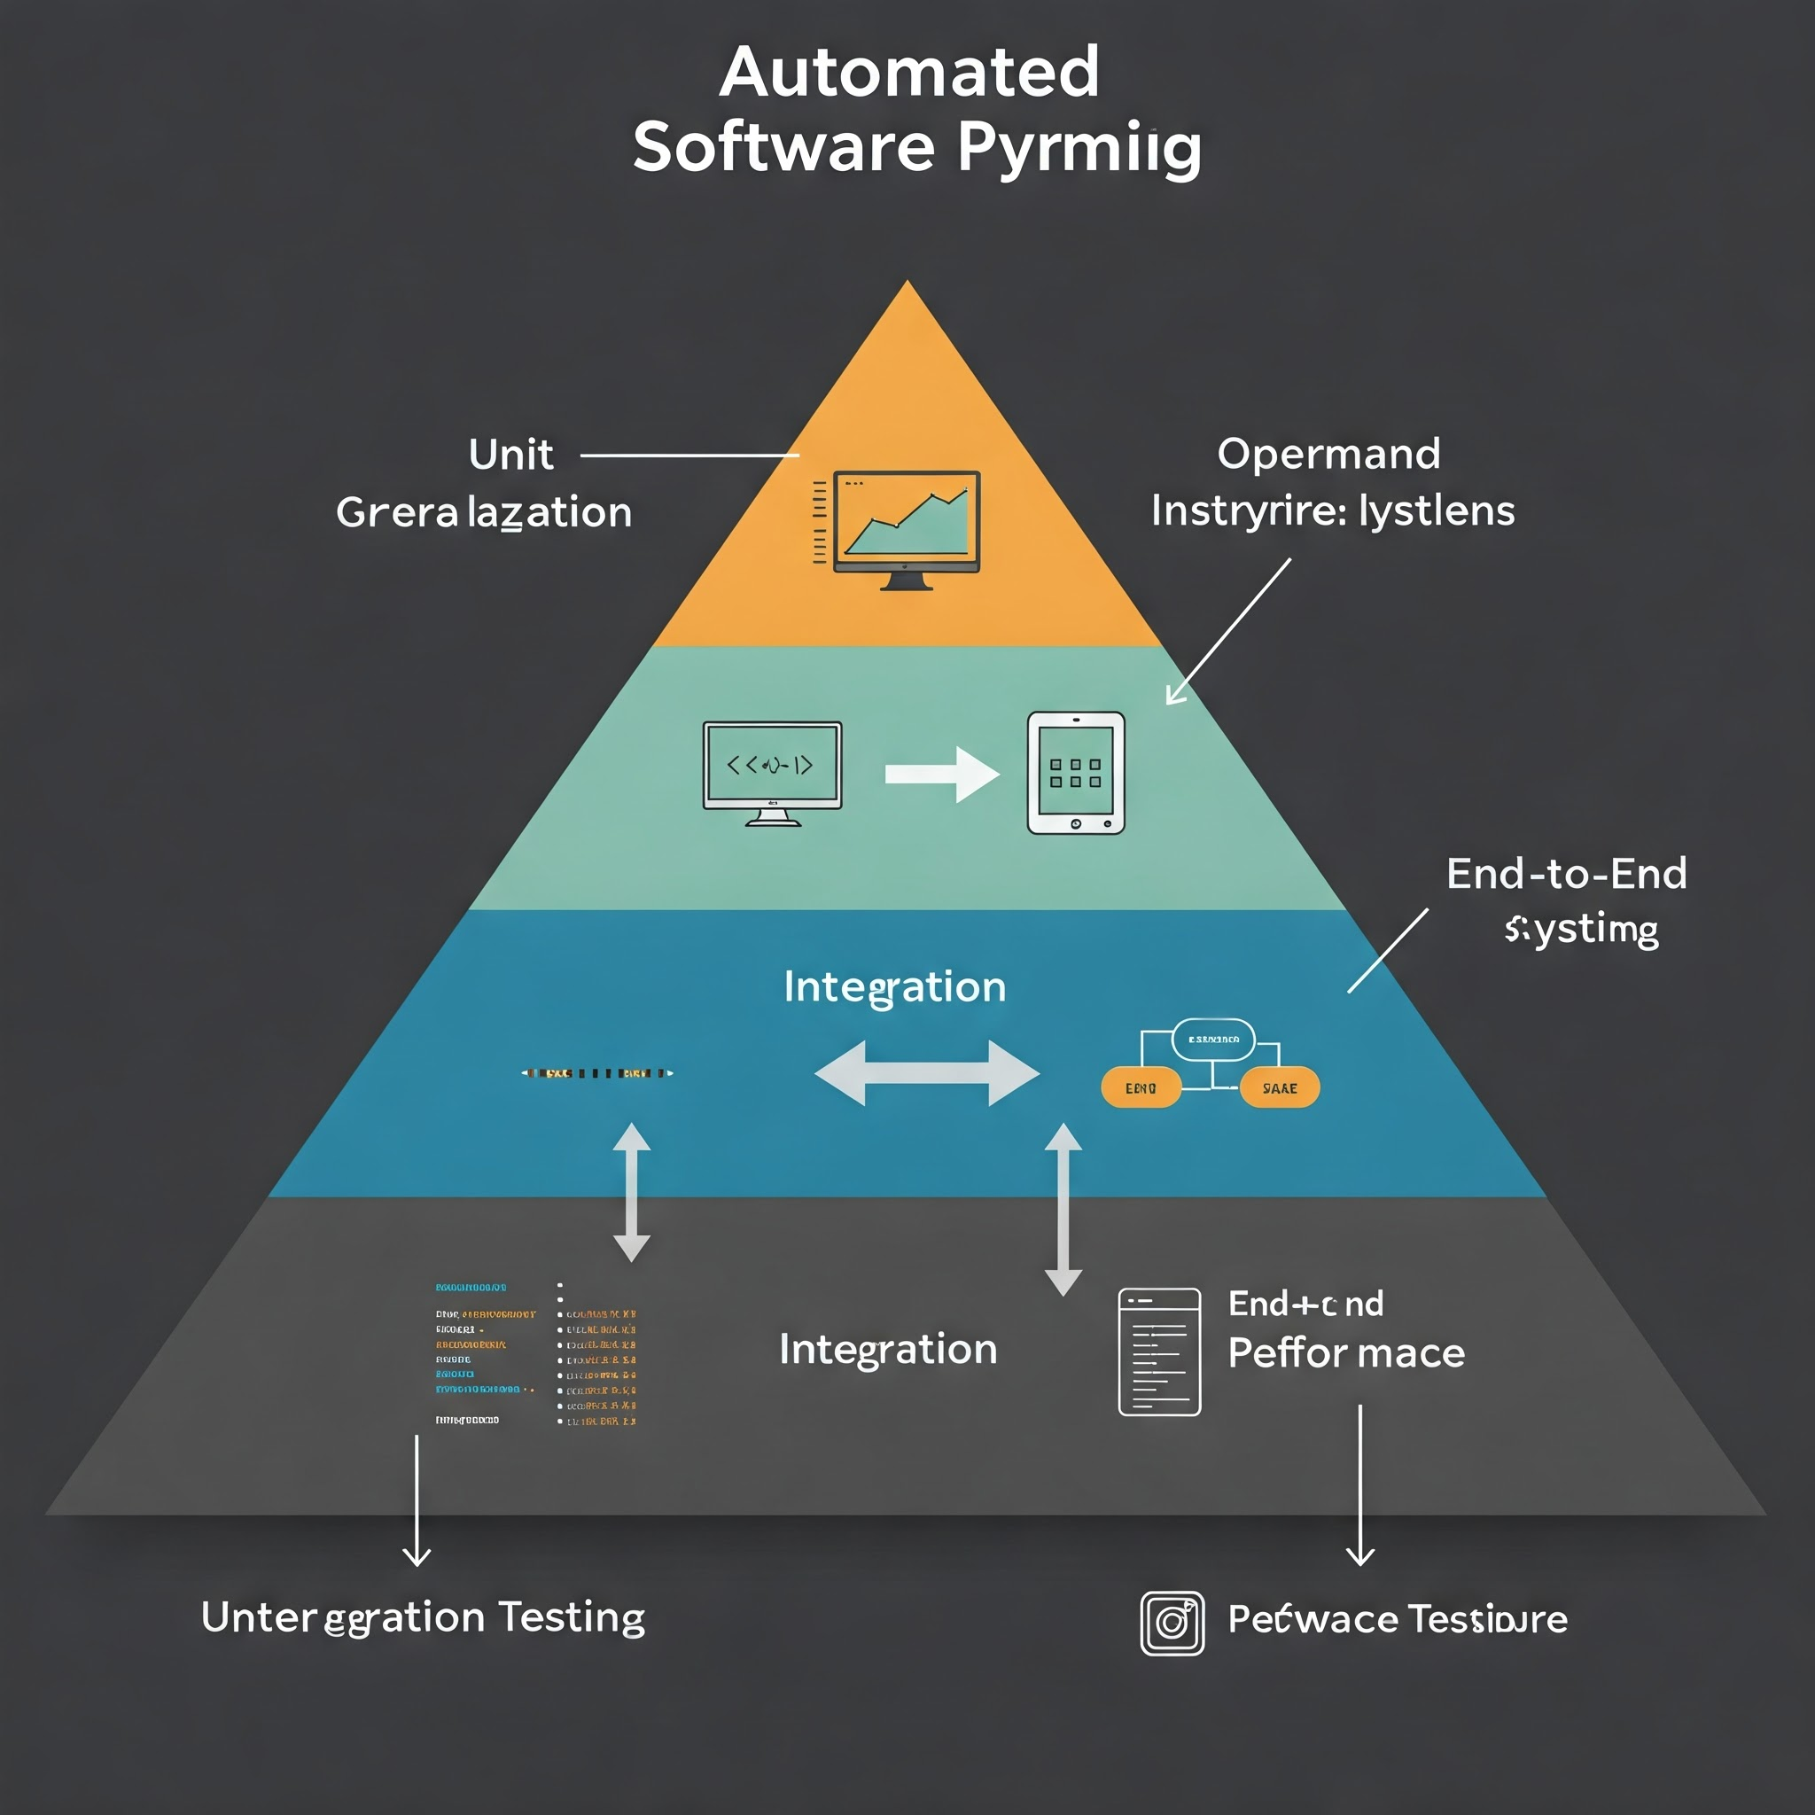
Built-In Quality, Security, Compliance
Continuous QA, Security, and Compliance are emphasized throughout the process.
Automated Testing Strategies include Unit, Integration, E2E, and Performance tests.
Security by Design uses threat modeling and automated testing.
Continuous Compliance ensures checks, evidence, and reporting always happen.
Notes:
IV. Ensuring Quality, Security, and Compliance
A. Emphasize the continuous integration of QA, security, and compliance throughout the process.
B. Automated Testing Strategies: Unit, integration, E2E, performance.
C. Security by Design: Proactive threat modeling, secure coding guidance, automated security testing (SAST/DAST/SCA).
D. Continuous Compliance: Policy interpretation, automated checks, evidence collection, and reporting.

Slide 7

AI Advantage: Fast & Secure
Drastically accelerated development cycles are a key benefit.
Improved consistency and a significant reduction in human error.
Enhanced adherence to security and compliance standards is achieved.
Potential exists to handle the increasing software complexity.
Strategic advantage gained through automation and overall efficiency.
Notes:
V. Benefits and Strategic Advantages
A. Drastically accelerated development cycles.
B. Improved consistency and reduced human error.
C. Enhanced adherence to security and compliance standards.
D. Potential to handle increasing software complexity.
E. Strategic advantage through automation and efficiency.

Slide 8

AI Challenges and Futures
Acknowledge inherent challenges like PRD ambiguity.
Discuss AI agent limitations, for example, hallucination.
Improved interfaces are a key future research area.
Highlight future development in enhanced reasoning areas.
Notes:
VI. Addressing Challenges and Future Directions
A. Acknowledge the inherent challenges (e.g., PRD ambiguity, complex reasoning, context window limitations).
B. Briefly discuss the current limitations of AI agents (e.g., hallucination, lack of true understanding).
C. Mention ongoing research areas and future development: Enhanced reasoning, improved interfaces, standardized benchmarks, etc.

Slide 9

AI: Future is Now!
Reiterate autonomous software development vision with transformative potential.
Emphasize feasibility using current technology components effectively now.
Suggest starting with pilot projects and focus on augmentation.
Call to Action: Discuss next steps or collaboration options.
Notes:
VII. Conclusion and Call to Action
A. Reiterate the vision of autonomous software development and its transformative potential.
B. Emphasize the feasibility of components of this vision with current technology.
C. Suggest starting with pilot projects and focusing on augmentation before full autonomy.
D. Call to Action: Discuss next steps, potential collaboration, or further exploration of the proposed architecture.

Slide 10
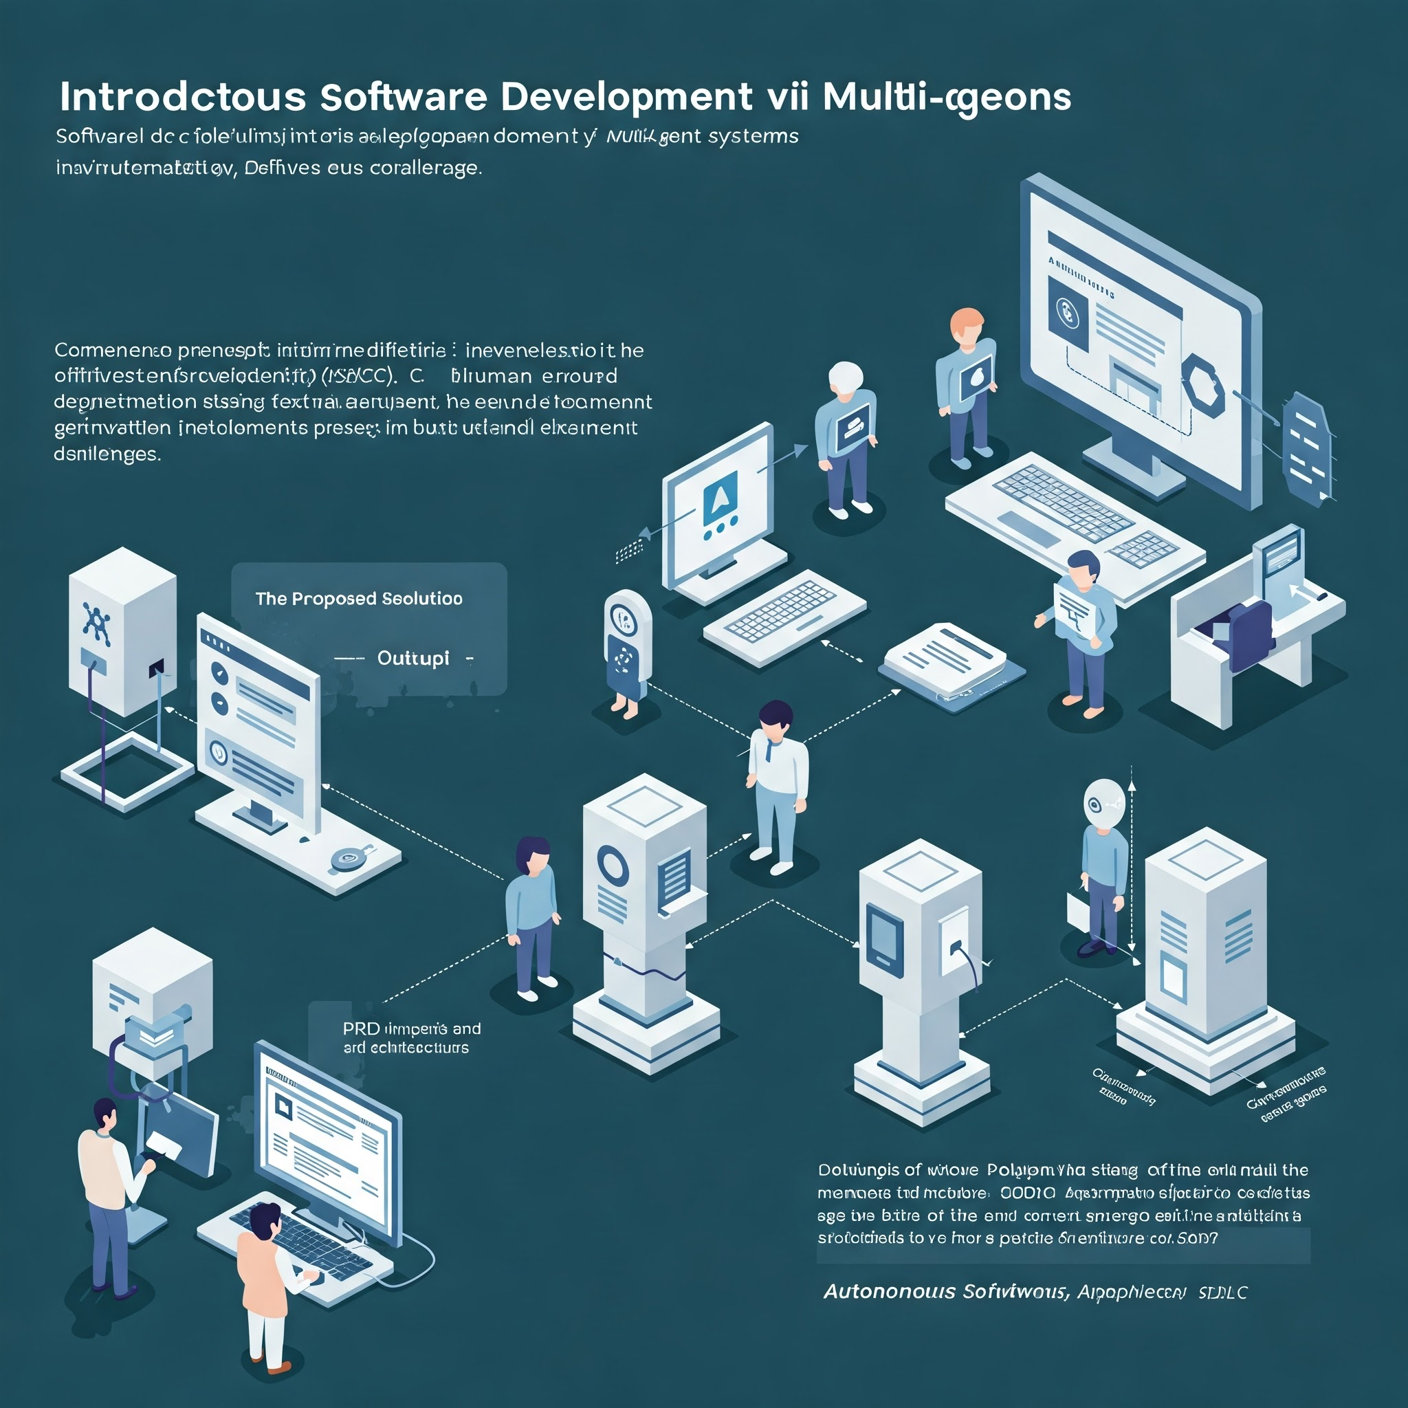

Slide 11
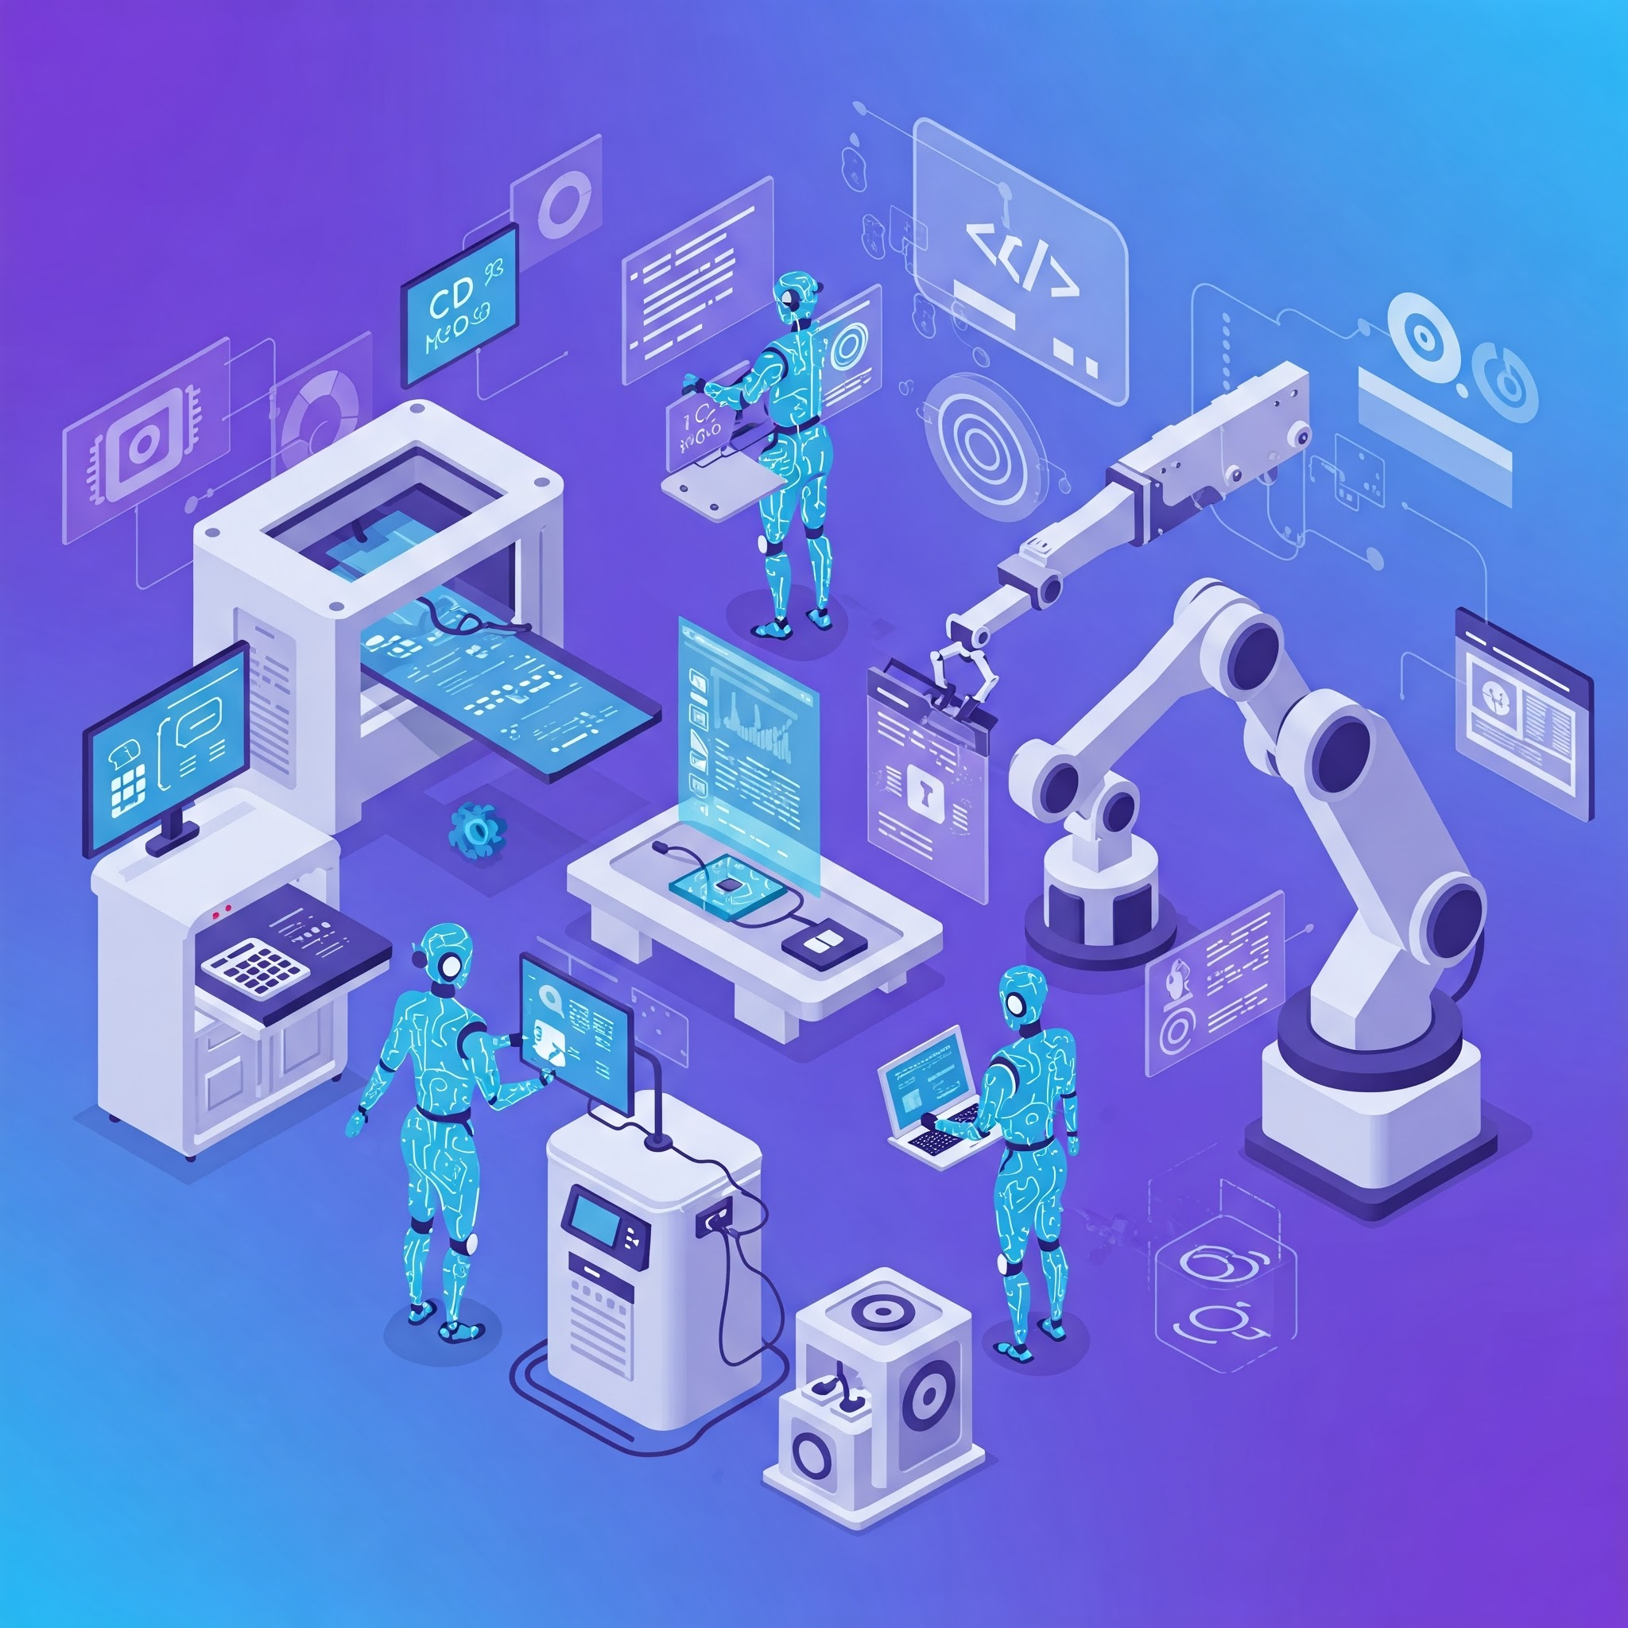
Software: Autonomy Unleashed
Current development faces cycles, errors, and complexity.
Autonomous Software Factory transforms PRD into software.
Specialized AI agents manage the automated development process.
Quality, security, compliance are built into the process.
Automation enhances efficiency and provides strategic advantage.

Slide 12

Autonomy Unleashed: PRD to Production
Automate PRD to production with AI agents.
Specialized agents for coding, testing, and deployment.
Achieve faster cycles, quality, security, compliance.
Multi-agent framework enables autonomous software factory.
Revolutionize SDLC with AI-driven development process.

Slide 13

Automation Revolution
AI Agents automate development from PRD to production.
Specialized agents handle coding, testing, and deployment.
Achieving faster cycles with better quality and compliance.
Multi-agent framework enables an autonomous software factory.

